Slide 1
Implementation of 32 Bits RISC CPU using Verilog.
CMPE-220 Project Presentation
Rajat Gupta (012538877)
Rohith Lukkoor (009746165)
Saurabh Mane (012548094)
Bapugouda Urf Pradeep Patil (011483277)

Slide 2
Introduction
The Objective of this project is to design and implement a Reduced Instruction Set Computers (RISC) CPU using Verilog.”
Model-Sim.
Verilog.
RISC CPU.
CPU Architecture.
Implementation.
Simulation.
Output and Waveforms.

Slide 3
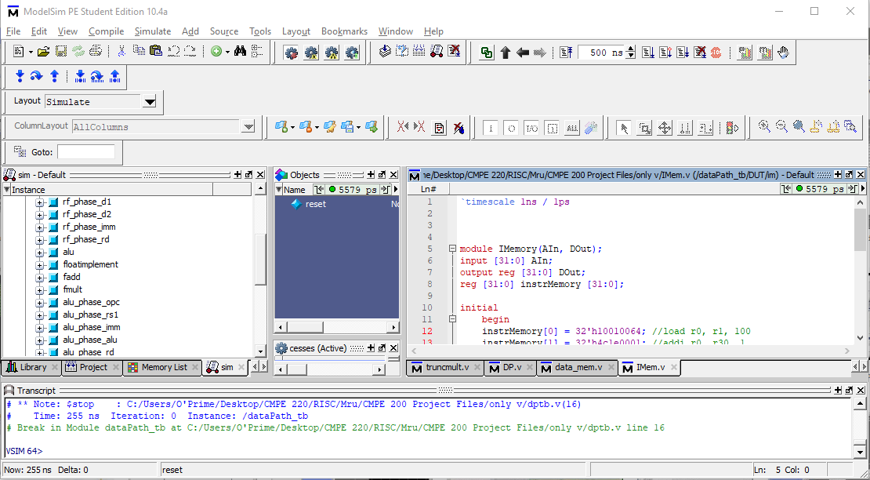
Model - Sim
Model-Sim is a multi-language HDL simulation environment by Mentor Graphics, for simulation of hardware description languages such as VHDL, Verilog and System C, and includes a built-in C debugger.”
Edition: Student Edition.
Version: 10.4 A.
Image Source: https://www.embitel.com/wp-content/uploads/2017/07/Bar-graph.png

Slide 4
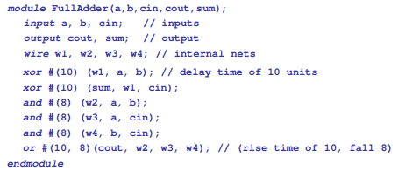
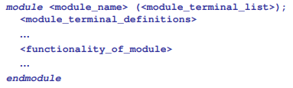
Verilog
Verilog is a Hardware Description Language; a textual format for describing electronic circuits and systems. Applied to electronic design, Verilog is intended to be used for verification through simulation, for timing analysis, for test analysis and for logic synthesis
Syntax
Example Code

Slide 5
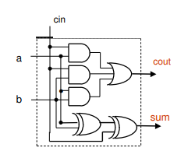
Verilog
Equivalent Circuit
Example Code

Slide 6
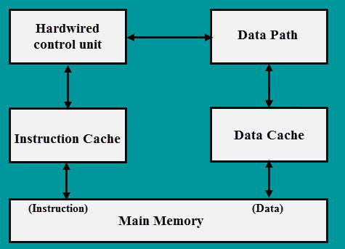
RISC CPU
Serial RISC (Reduced Instruction Set Computer) is a microprocessor that is designed to perform a smaller number of computer instructions so that it can operate at a higher speed .
Features of RISC CPU
Simple Instruction Set
Few Addressing Modes
Many Registers
Easy Pipelining
Harvard Architecture.
Image Source: https://www.efxkits.co.uk/wp-content/uploads/2017/05/RISC-Architecture.jpg

Slide 7
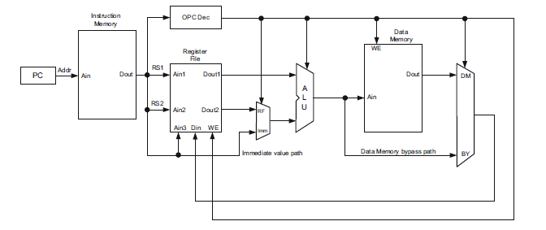
RISC CPU
ALU
ALU perform necessary operation according to control signal
Identifies what type of instruction
Op-Code Decoder
Data Memory
Instruction Begins with PC
Program Counter
ALU
Instruction Memory
IM
The address of the instruction to be executed is passed to IM and IM decode the instruction and sent different segment to register and opcode
Register File
retrieves data from register file
Image Source: “Fundamentals of Computer Architecture and Design”, by Dr. Ahmet Bindal

Slide 8
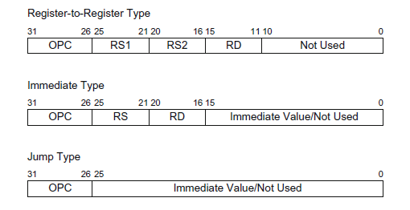
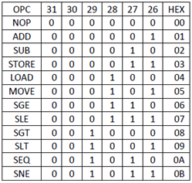
Architecture
Table 1. Instructions Opcode [1]
Figure 1 Instruction Register.[1]
Image Source: “Fundamentals of Computer Architecture and Design”, by Dr. Ahmet Bindal

Slide 9
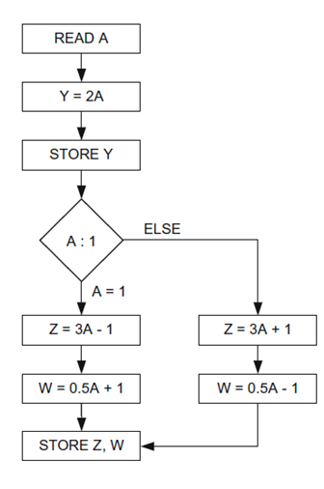
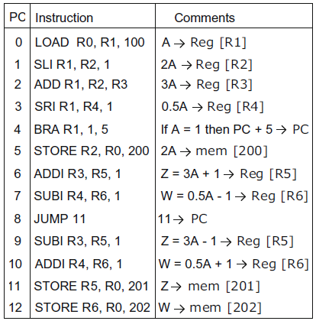
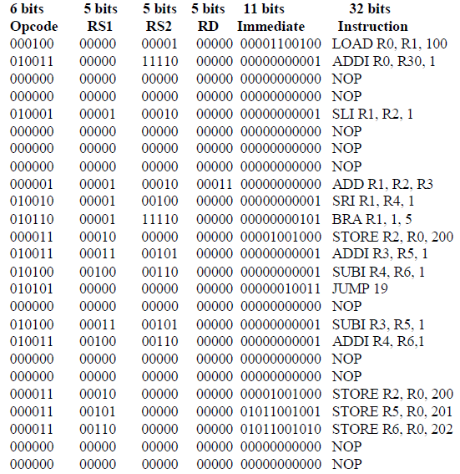
Flow Chart
Flow Chart
Program
Machine Code
Image Source: “Fundamentals of Computer Architecture and Design”, by Dr. Ahmet Bindal

Slide 10
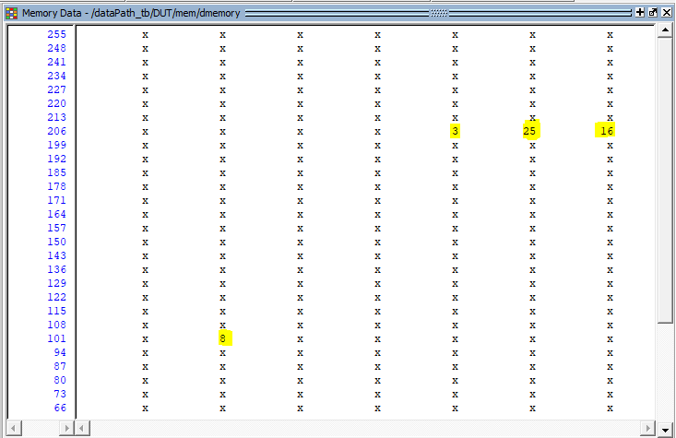
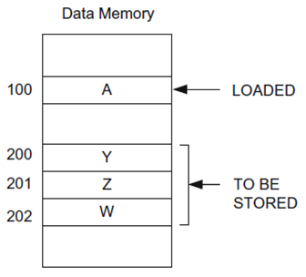
Memory Contents
Data Memory
8
16
25
03
Image Source: : https://www.mikroe.com/ebooks/architecture-and-programming.png

Slide 11
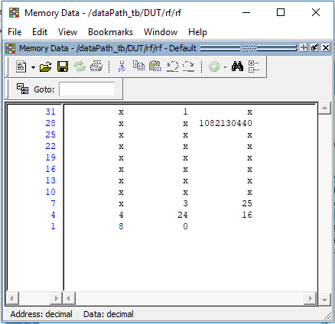
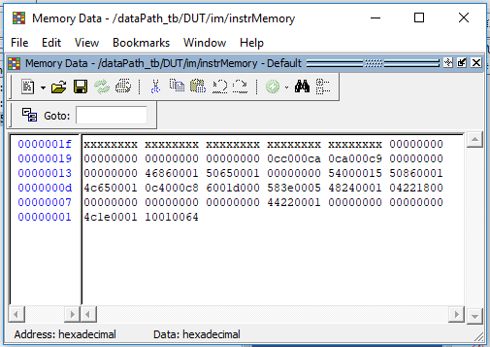
Memory Contents
Register File
Instruction Memory

Slide 12
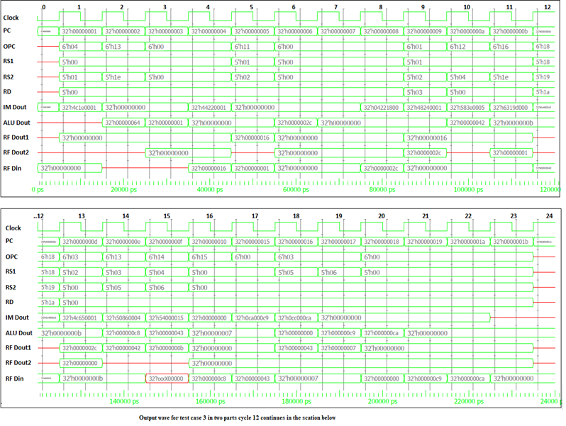
Output
Waveform

Slide 13
Conclusion
We successfully designed and implemented 32 Bit RISC Processor, gained valuable experience in Verilog programming and insights of the Model-Sim software. We also represented the data flow in terms of waveforms, also successfully verified the memory contents of both the memory modules.

Slide 14
THANK YOU!

